Slide 1

Project No. 15006313
Unity Seminar
Project Member: Melanie Sverdlov
Seminar Advisor: Moshe Sulamy

Slide 2
Presentation Contents
Game Overview
Other Similar Games
Game Demo
Architecture
Technologies
Roadmap

Slide 3
Game Overview

Slide 4
Card Game Simulator is a video game that aims to simulate various card games in a tabletop way.

Slide 5
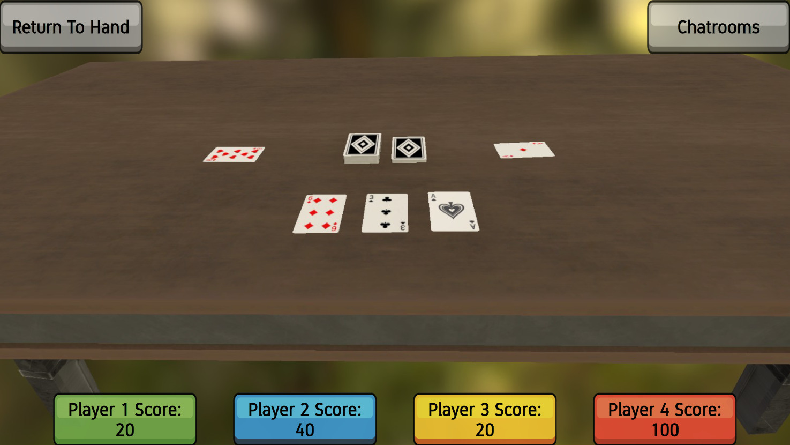

Slide 6
Choose from a variety of games, and play with friends over a local network.
No Internet connection required to play.

Slide 7
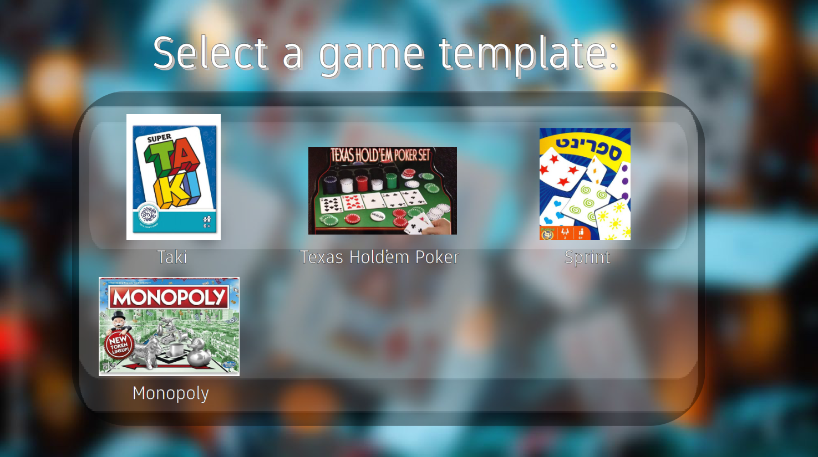

Slide 8
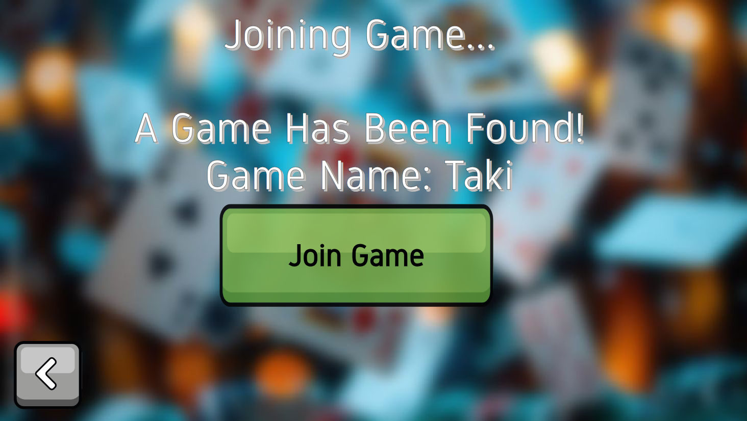

Slide 9
Create new card game templates, for other players to experience and enjoy,
with many options for customization.

Slide 10
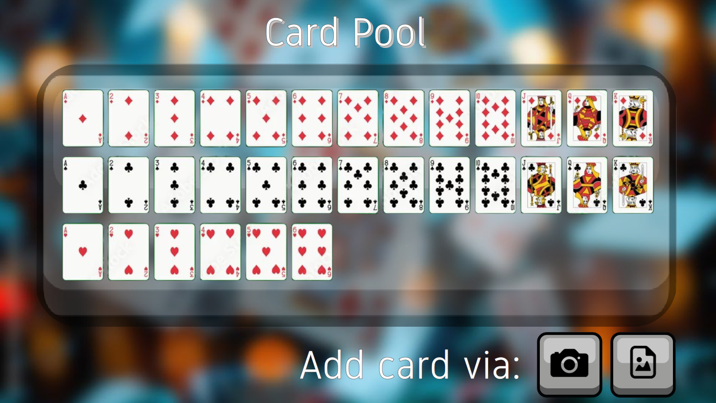

Slide 11
Use a secondary device,
like a tablet,
to show the game table.

Slide 12
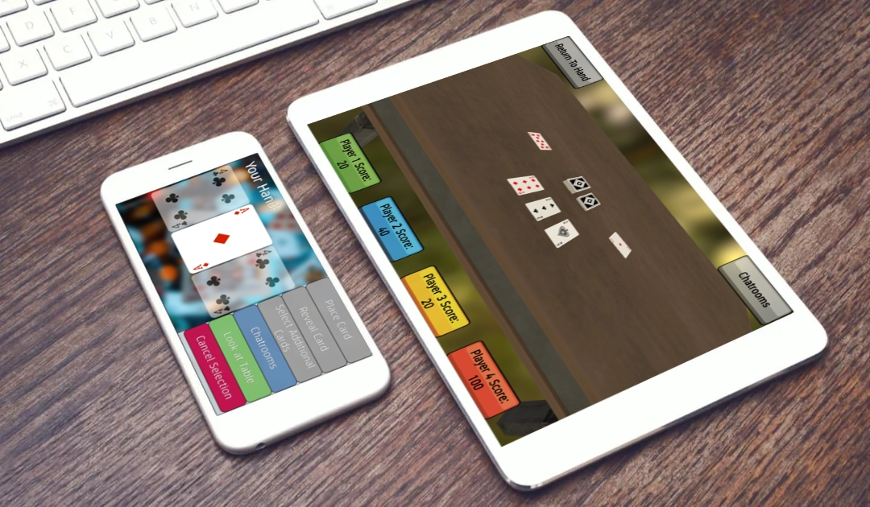

Slide 13


Other Similar Games

Slide 14
Game Demo

Slide 15
Architecture

Slide 16
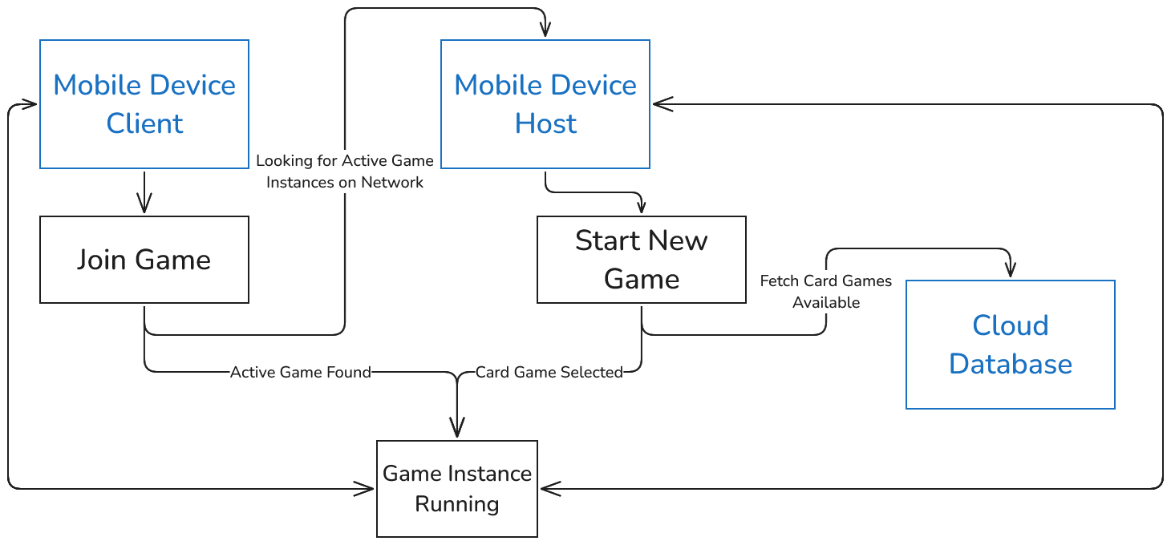
System Components

Slide 17
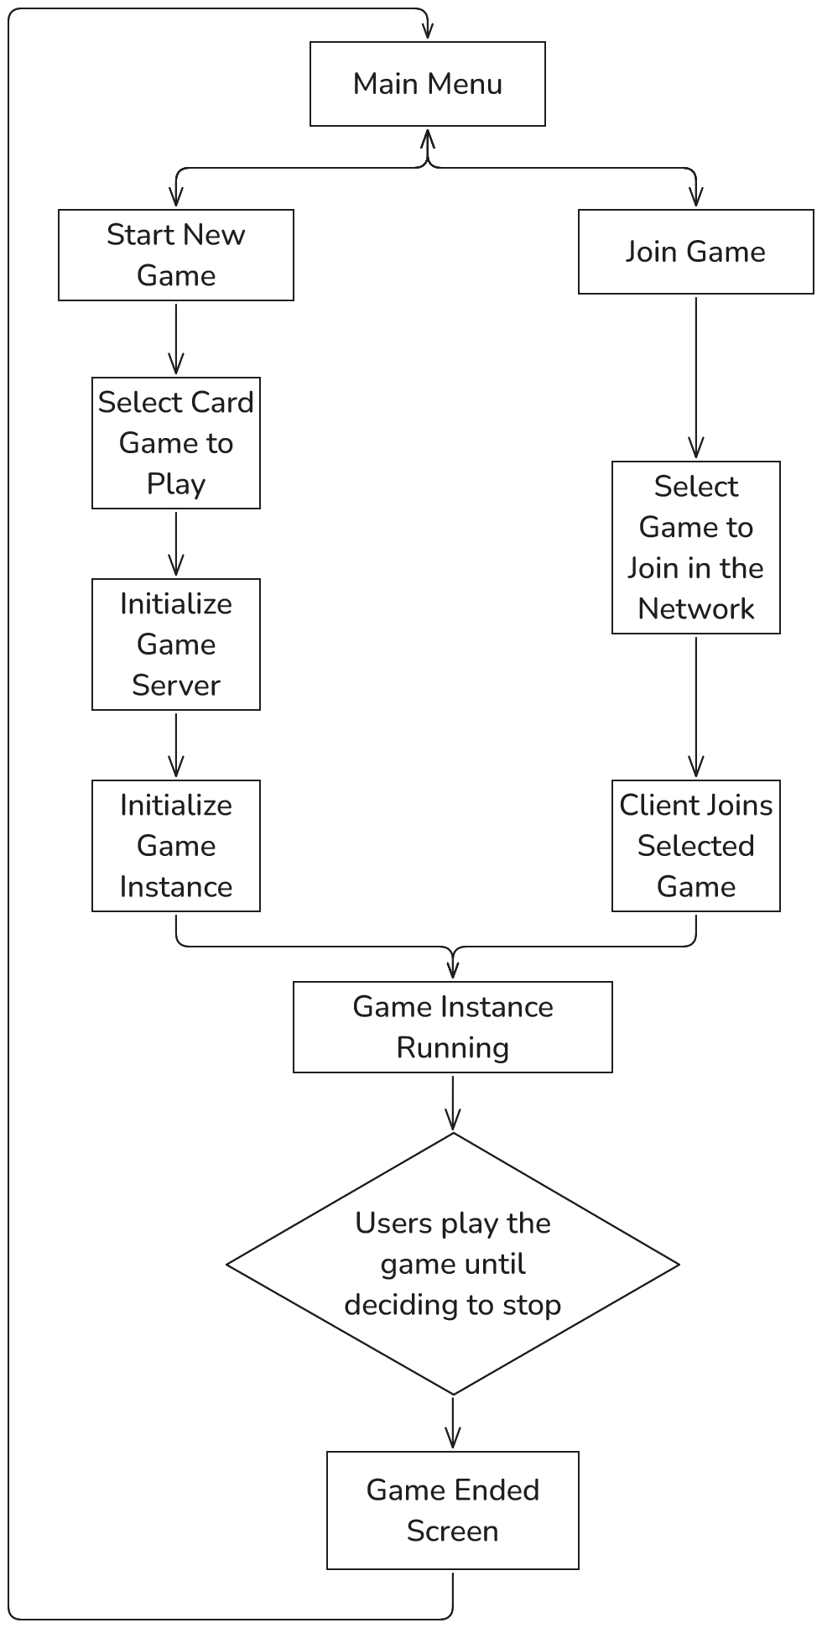
Game Instance
User Flow

Slide 18
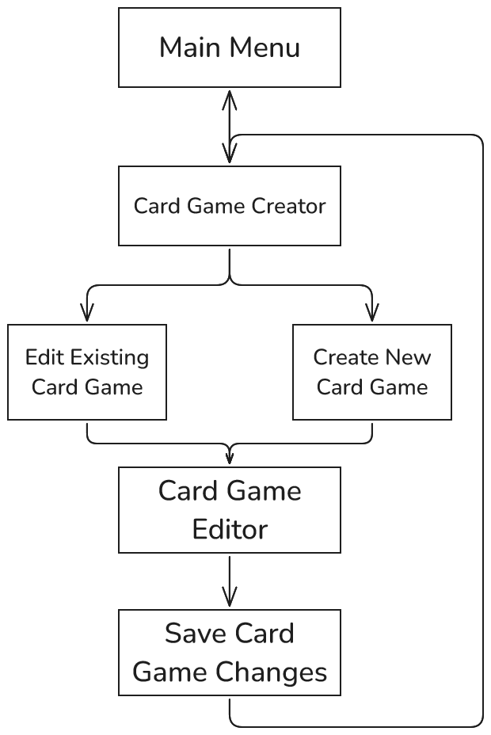
Game Template
User Flow

Slide 19
Technologies

Slide 20




Technologies at Use:
With a little

Slide 21


Previously Considered Technologies:

Slide 22
Roadmap
Simulator Implementation
Networking Integration
Card Game Editor
Cloud Database
And so on...

